Slide 1
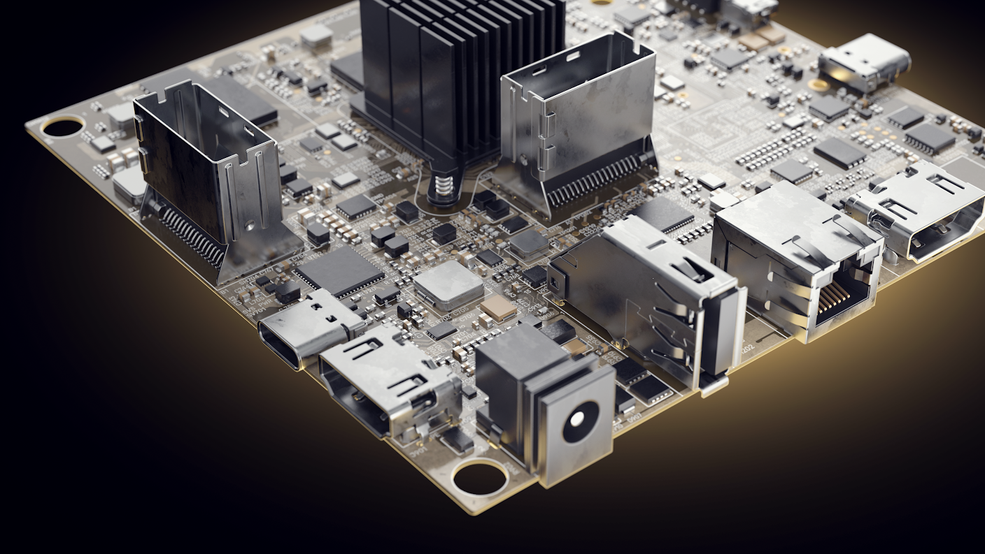
Altium Designer
Introduction to Electronic Design Automation
Fall 2023

Slide 2

What is ECAD or Electronic Design Automation?
ECAD is the process of digitally capturing an electronic design. Typically, a designer or engineer will do this to enable better sharing methods or to lay out custom PCB artwork for their project.

Slide 3
Project Prep
Getting familiar with the Altium Designer Software

Slide 4
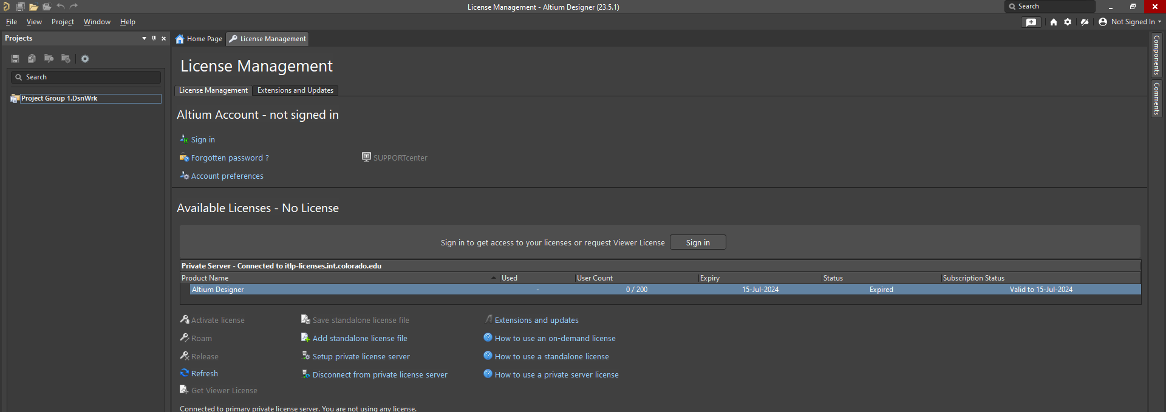
Open Altium Designer
Altium is a very powerful software, it may take more than a few seconds to load.

Slide 5
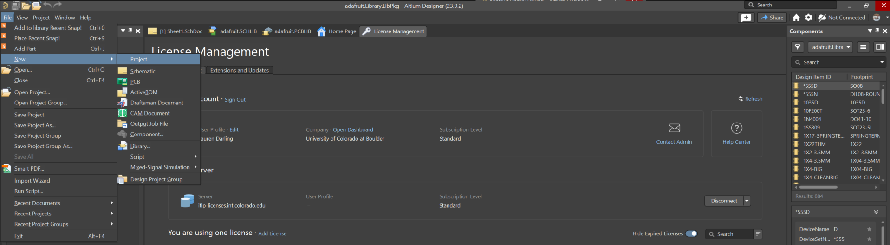
Begin a New Project
All your files need to nest into a PCB project it will store as the extension .pcbprj
FILE > NEW > PROJECT

Slide 6
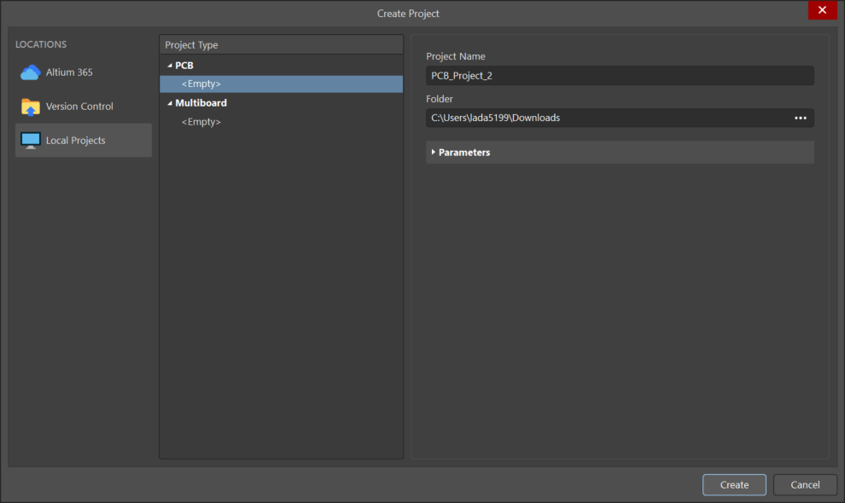
We recommend you do not use any spaces
Press Create to Lock in your choice

Slide 7
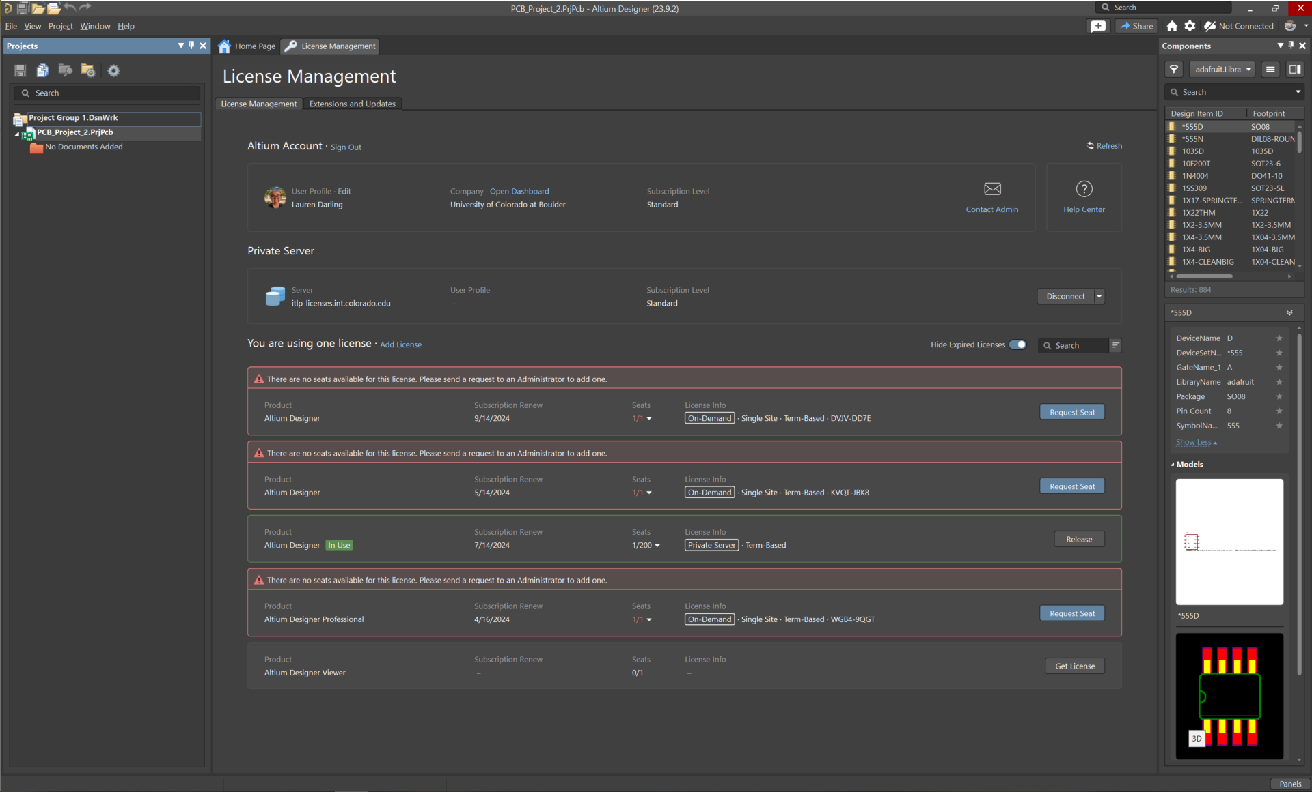

Everything will exist in your “projects” tab on the left side of your screen.

Slide 8
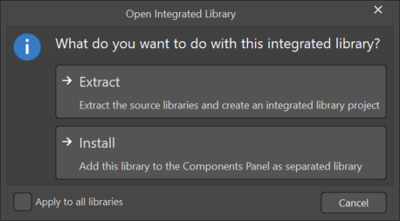
Install a library
ITLP.link/WorkshopResources
→ECAD
→Altium
In Altium Designer there are many ways to get the parts you need to make a successful design. We will use a pre-made library from Eric Bogatin’s PCB Class for our exercises today.
DRAG AND DROP the file
“ECEN5730Lib_2023_05_DS.IntLib”
into your Altium Software Window.

Slide 9
Schematic Capture
The process of getting the parts from your breadboard or prototype into digital space.

Slide 10
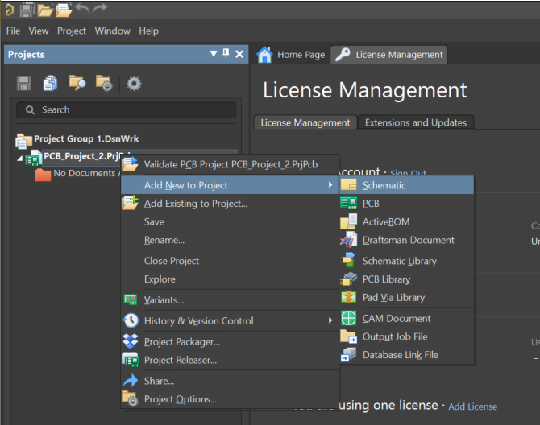
Begin by adding a schematic to your project.
Right click on your project.
Add New to Project
Schematic

Slide 11
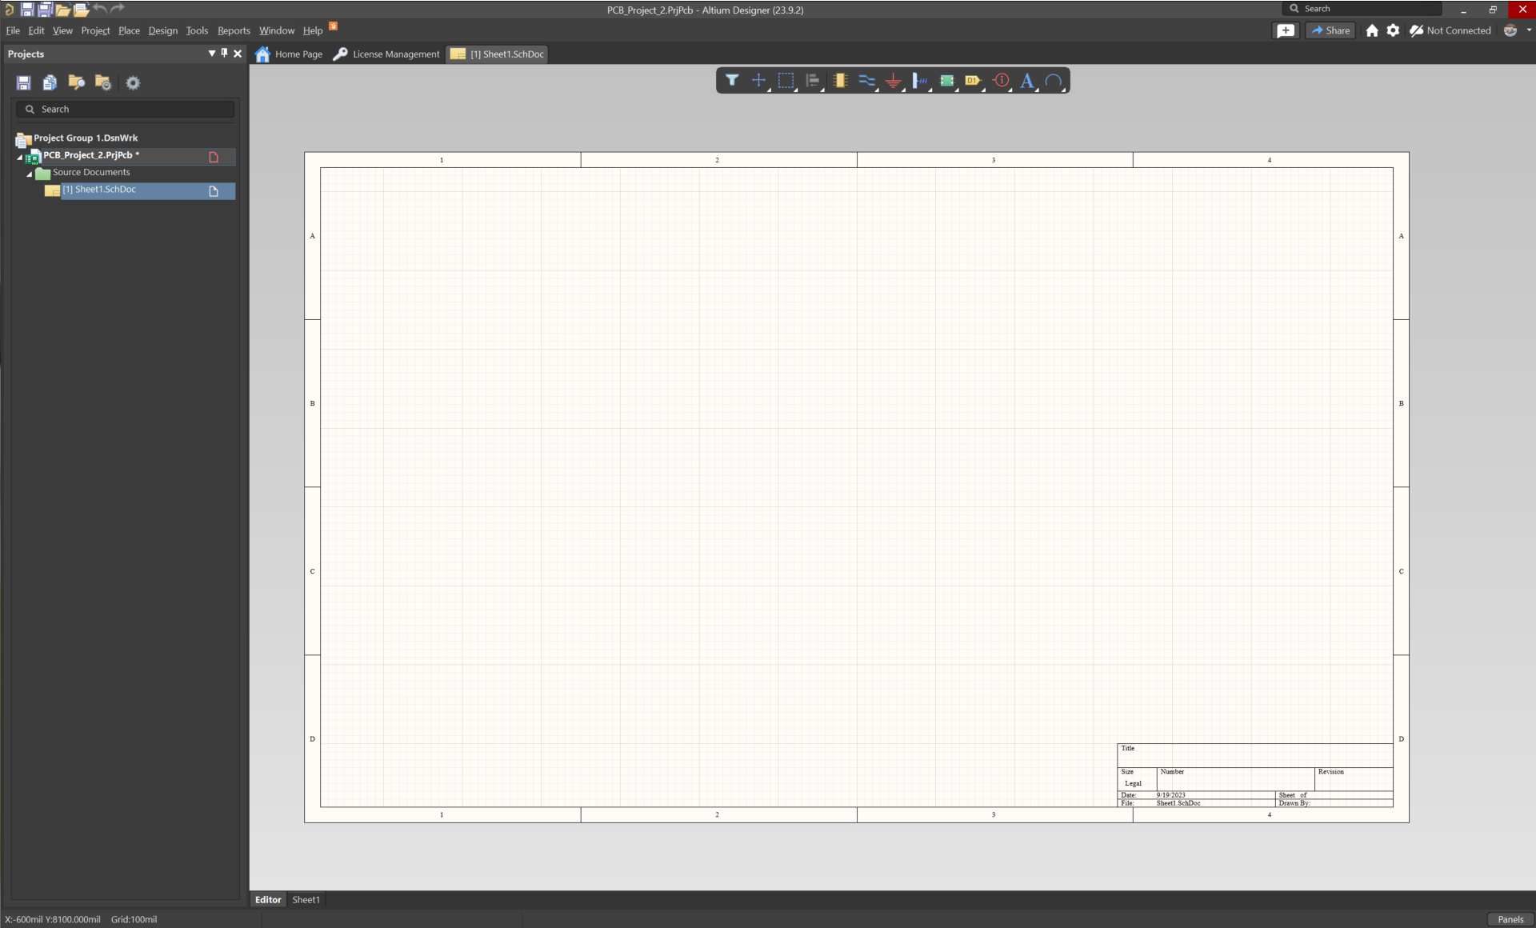
HEADS UP Toolbar
This is the schematic workspace, here is where a design begins. The purpose of a schematic is to be a detailed map explaining what your circuit does. It is not meant to look like your final printed circuit board.

Slide 12
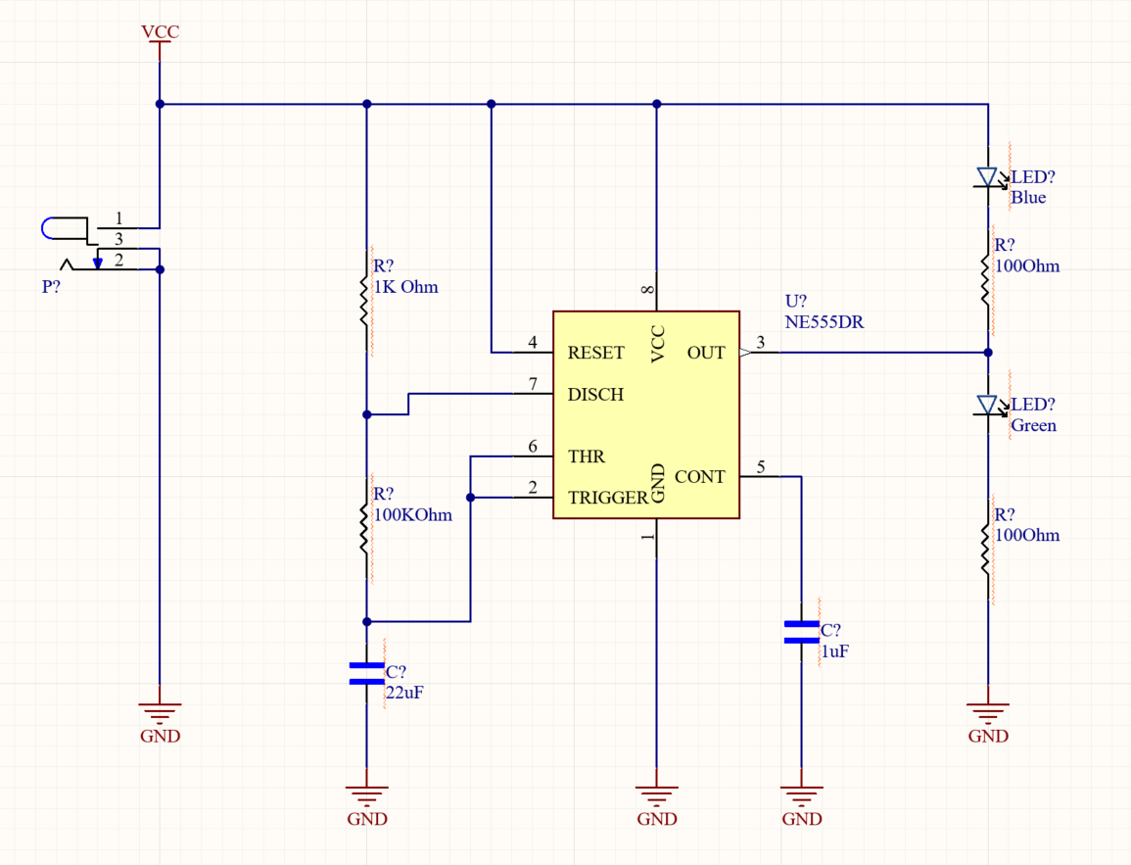
The schematic

Slide 13
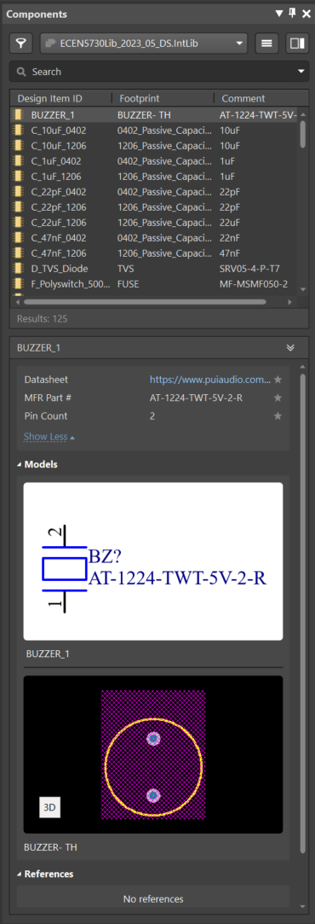

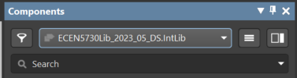
Place Parts
Using the Heads-Up Tool Bar, select the place part icon.
Your Components Panel should pop up on the right side. >
Make sure the library selected says “ECEN5370…”

Slide 14
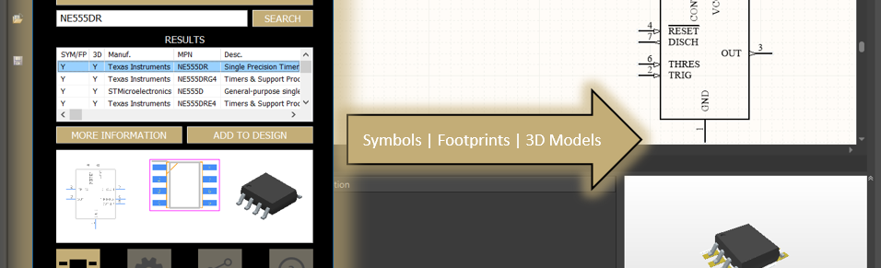
Populate the components
When selecting parts, you either chose from a pre-made library or must make your own.
We have provided the library that the Electrical Department uses for their Practical PCB Design Class as a way to get started easily with Altium Designer.
Components carry 3 important pieces of information: the symbol, the footprint, and occasionally the 3D model.

Slide 15
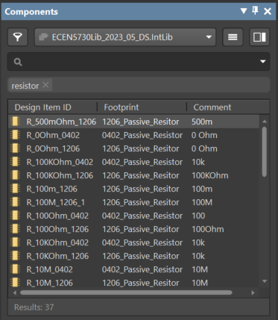
Populate the Resistors
Search: “Resistor”
Place:
2 x R_100Ohm_1206
1 x R_100KOhm_1206
1 x R_1KOhm_1206

Slide 16
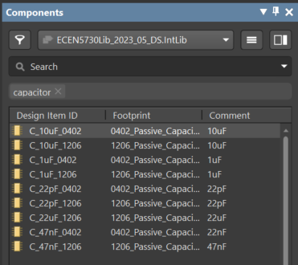
Populate the Capacitors
Search: “Capacitor”
Place:
C_1uF_1206
C_22uF_1206

Slide 17
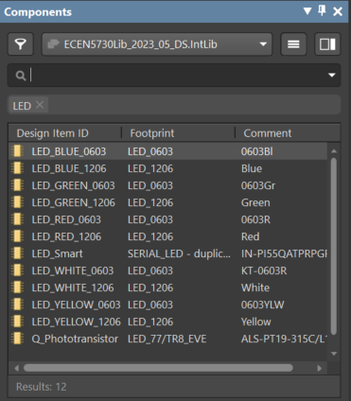
Populate the LEDs
Search: “LED”
Place:
2 x LED_(color)_1206

Slide 18
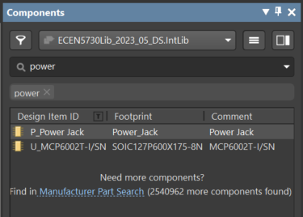
Populate the Power Port
Search: “power”
Place:
P_Power Jack

Slide 19
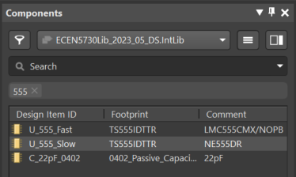
Populate the Timer
Search: “555”
Place:
U_555_Slow

Slide 20
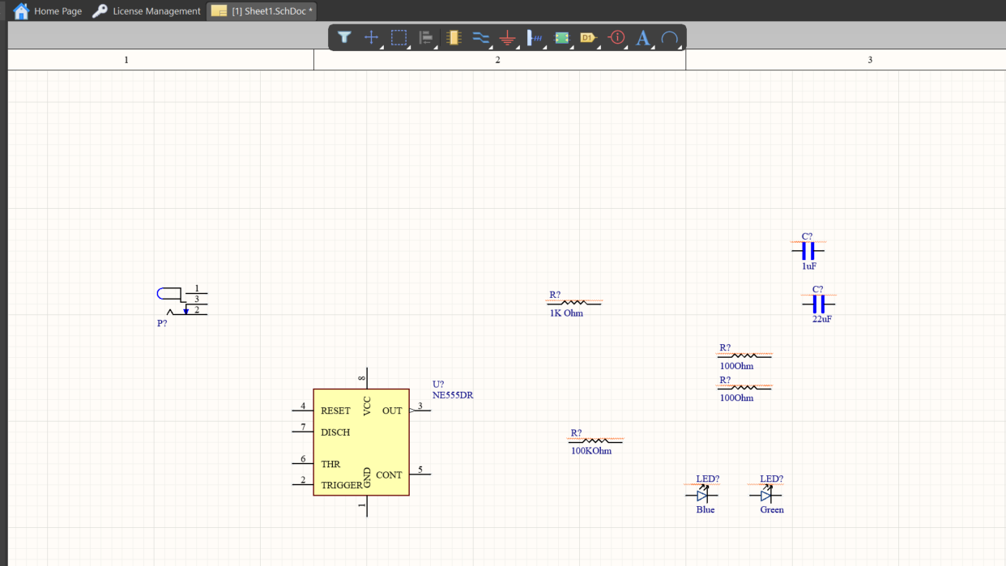
Progress so far…

Slide 21



Annotate Power and Ground
Click the symbol on the Heads-Up Tool Bar that looks like a ground symbol.
If you right click it, you will get more options (notice the little triangle in the bottom right corner?)
Place a few grounds along the bottom of the schematic.
Place a Power symbol at the top left.

Slide 22
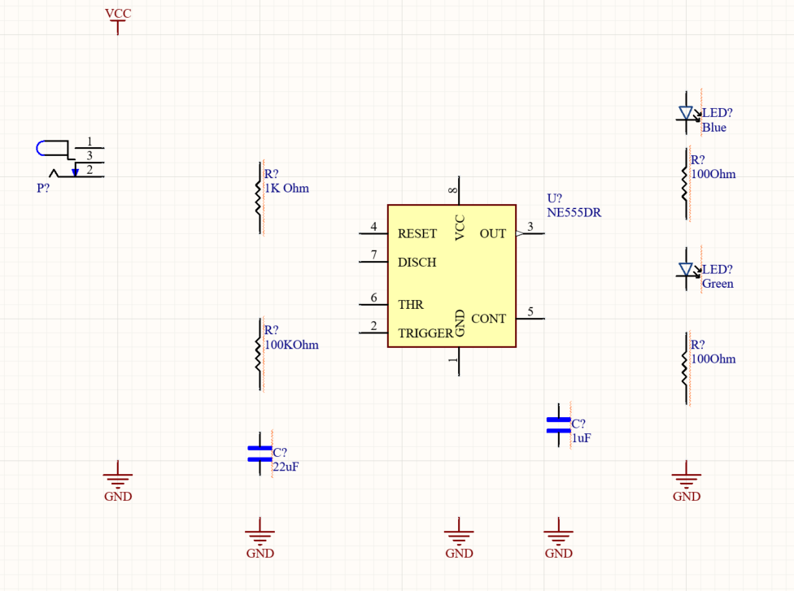
Organize the circuit…

Slide 23
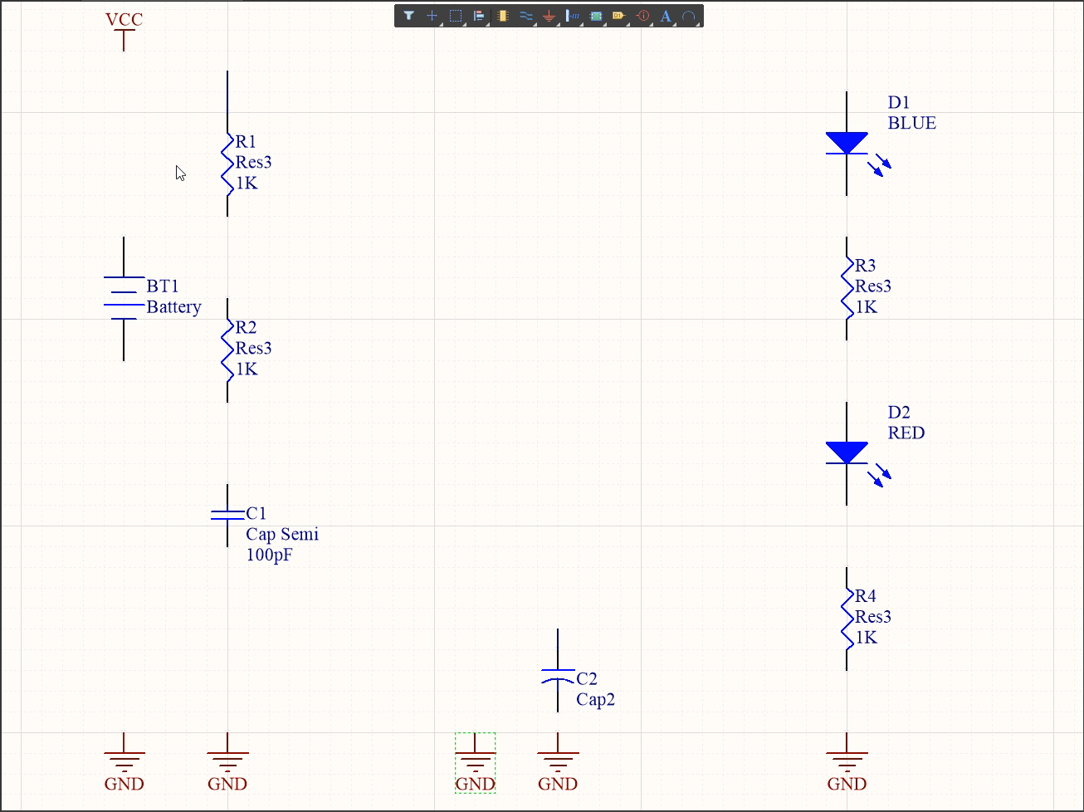
Build the network of connections

Slide 24
Wired up!

Slide 25
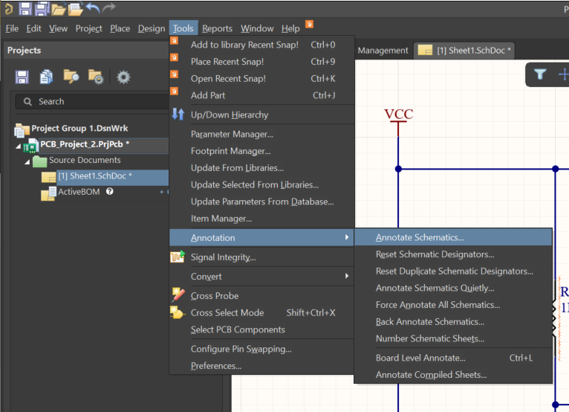
Annotate the schematic
TOOLS >
ANNOTATION >
ANNOTATE SCHEMATICS

Slide 26
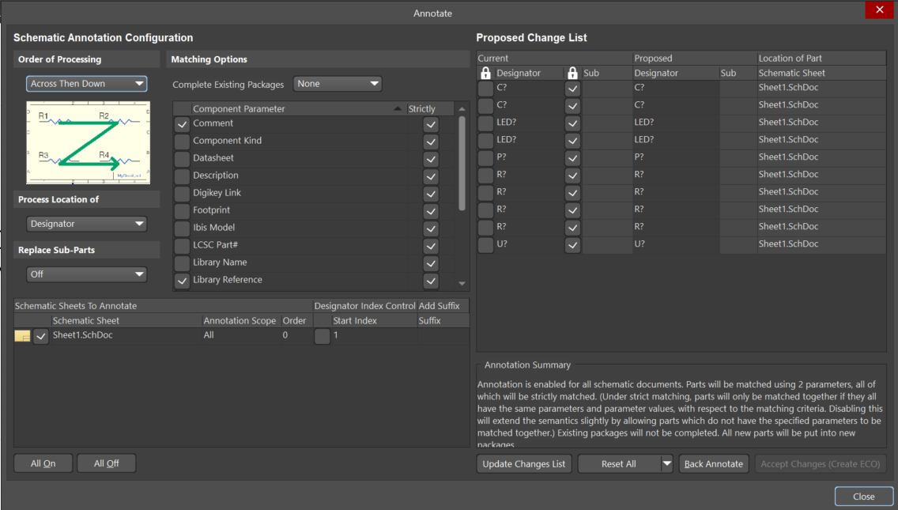
Automatically Annotate Schematics
UPDATE CHANGE LIST
OKAY!
Engineering Change Order (ECO)
Validate
Execute
Close
Close

Slide 27
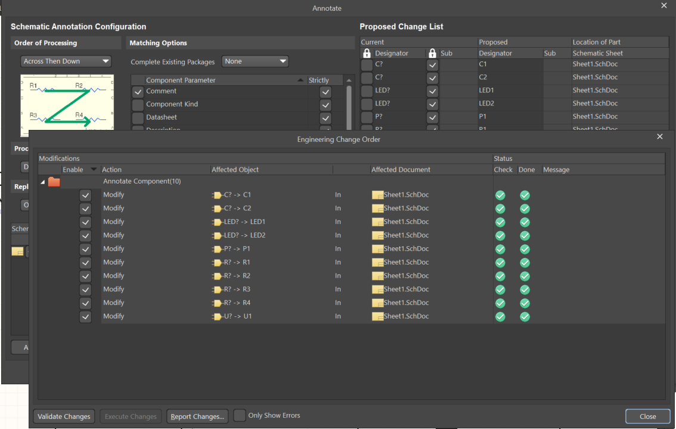
Automatically Annotate Schematics
UPDATE CHANGE LIST
OKAY!
Engineering Change Order (ECO)
Validate
Execute
Close
Close

Slide 28
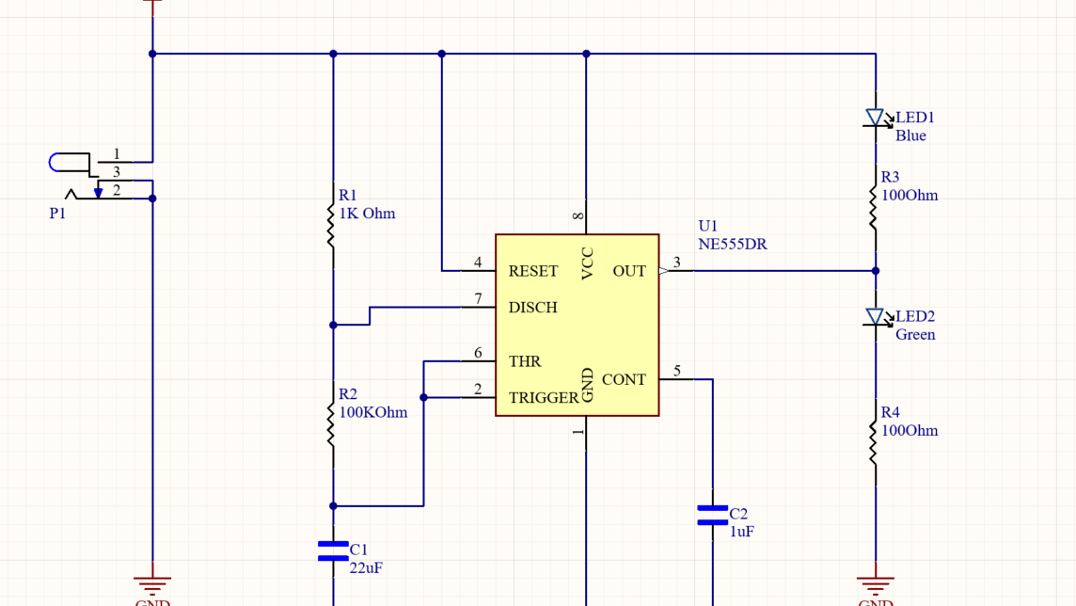
Final Schematic! (Save your work here)

Slide 29
PCB Layout
The process of taking your schematic content and generating the artwork used to manufacture printed circuit boards.

Slide 30
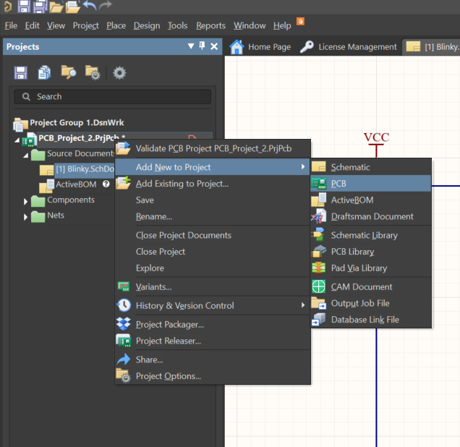
Create a new pcb
Right Click Project
Add New to Project
PCB

Slide 31
SAVE​
SAVE​ NOW
REALLY, SAVE​
SAVE​, PLEASE

Slide 32
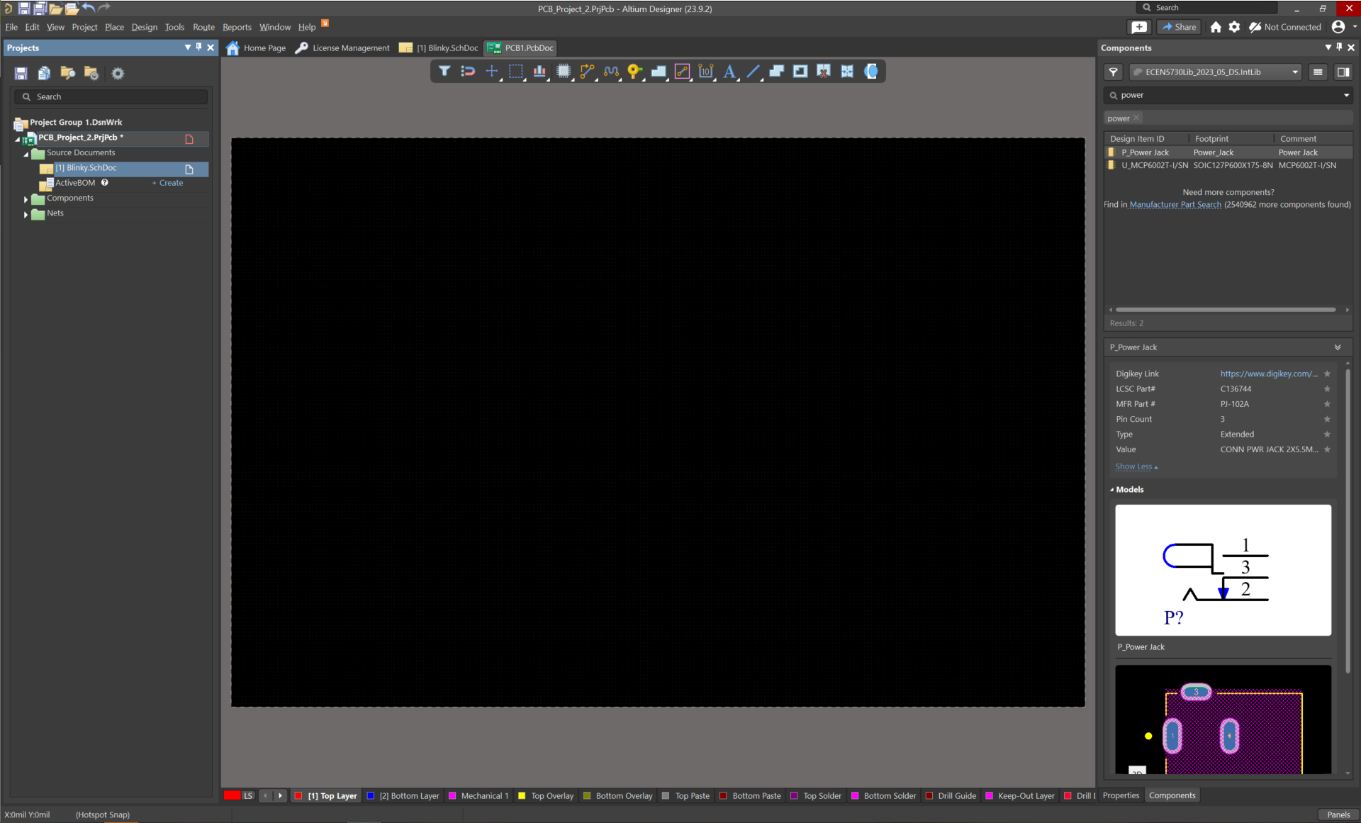
HEADS UP Toolbar
This is the pcb layout workspace, here is where artwork generation begins. The purpose of a pcb is to execute the requirements of your schematic. This is your final product and often has constraints around size.

Slide 33
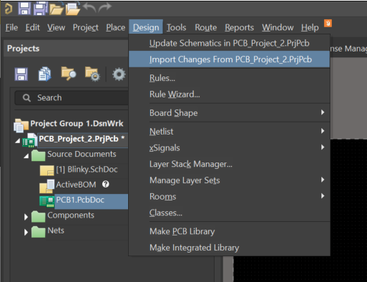
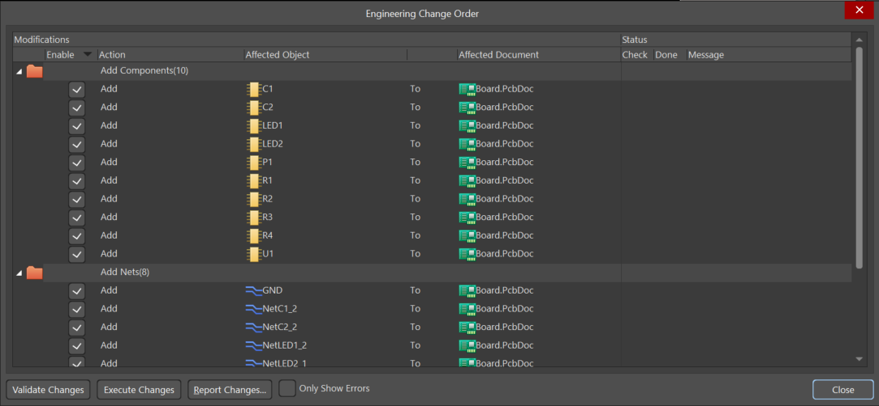
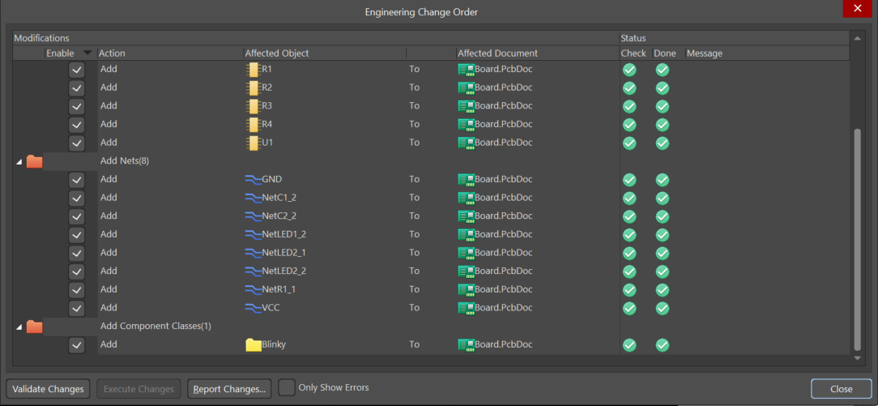
Bring in content from the project
PCB1.PcbDoc
-> Right Click -> Save
Press VALIDATE, EXECUTE

Slide 34
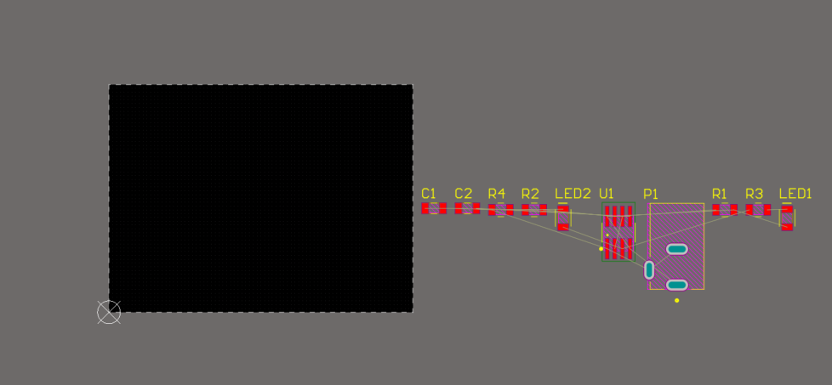
Zoom out to see your parts

Slide 35
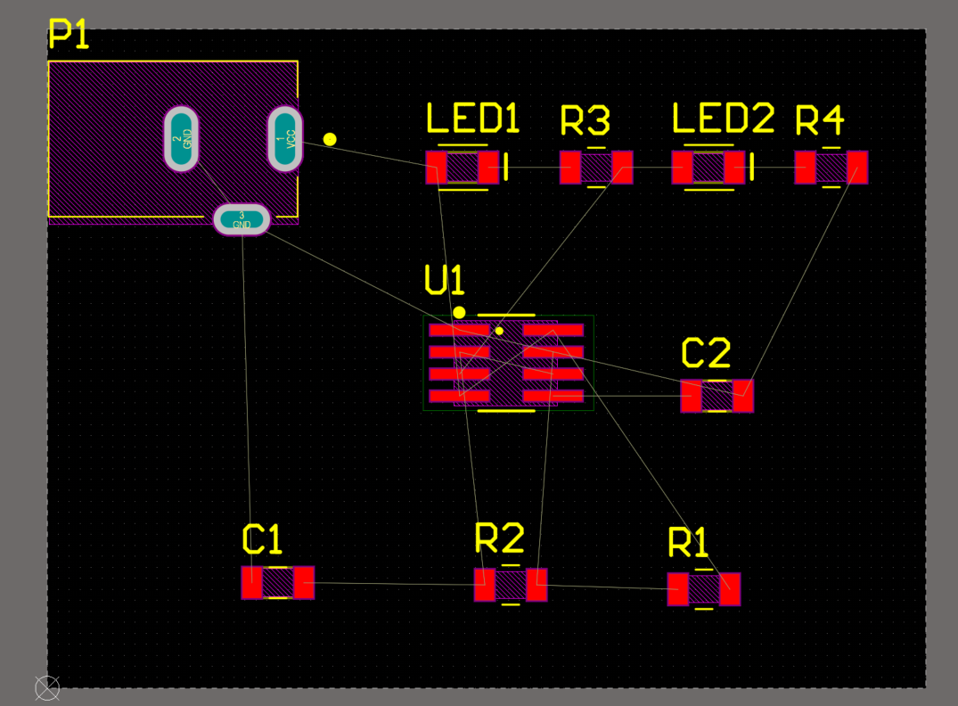
Rearrange to Reduce Criss Cross

Slide 36
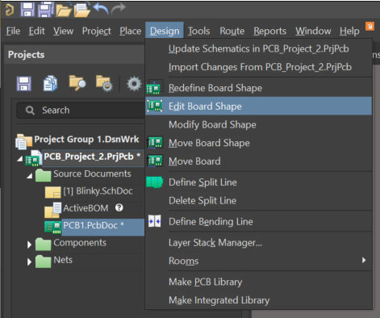
Change the size
Navigate to board planning mode by pushing the number 1 on your keyboard.
Use Design > Edit Board Shape to make your board 1.5” by 2”

Slide 37
Add Ground Plane
Press the Number 2 to return to Layout Mode.
Use Polygon Tool
Draw Boundary
Right Click to End
Right Click to Pour
Shelve
Unshelve using Tools > Polygon Actions > Unshelve All.

Slide 38
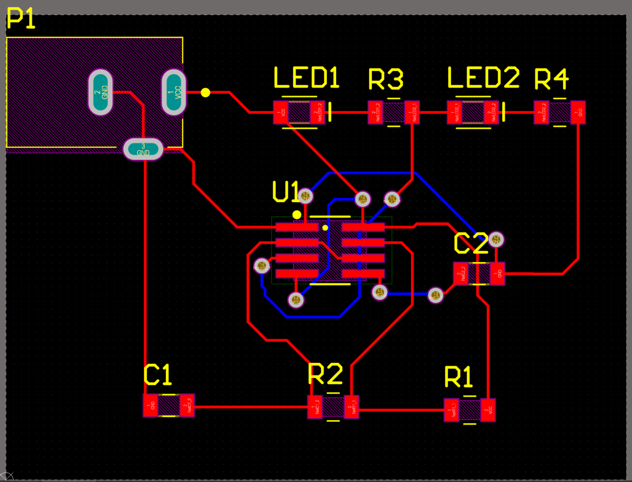

Route the physical tracks

Slide 39
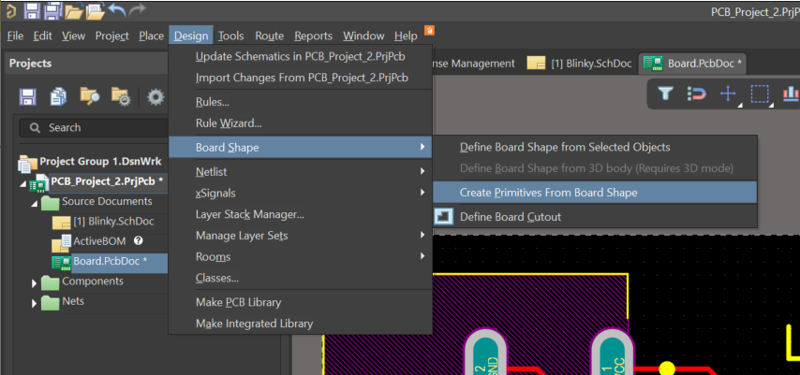
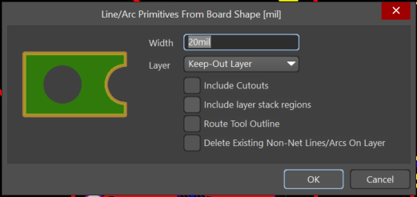
Define the board edge

Slide 40
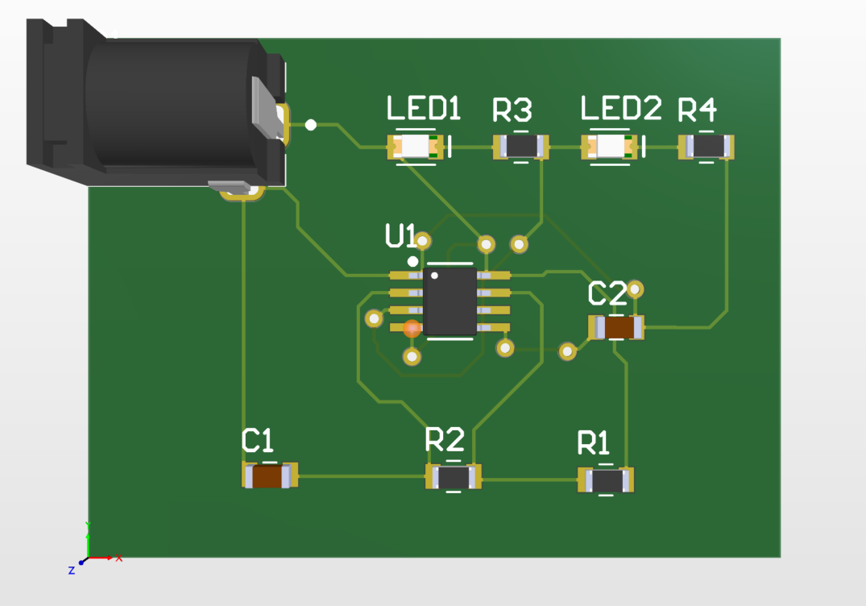
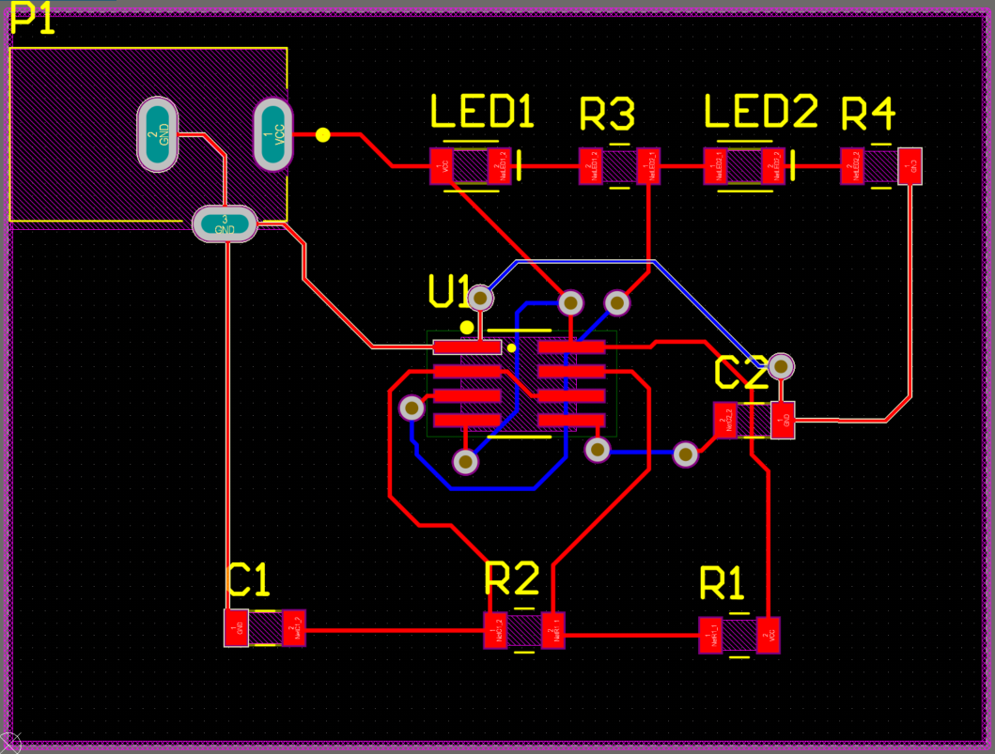
The final board

Slide 41
File Generation
Taking your design to industry for manufacturing.

Slide 42
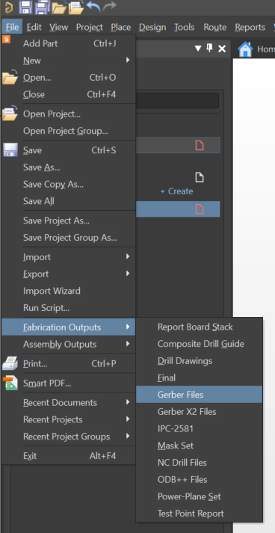
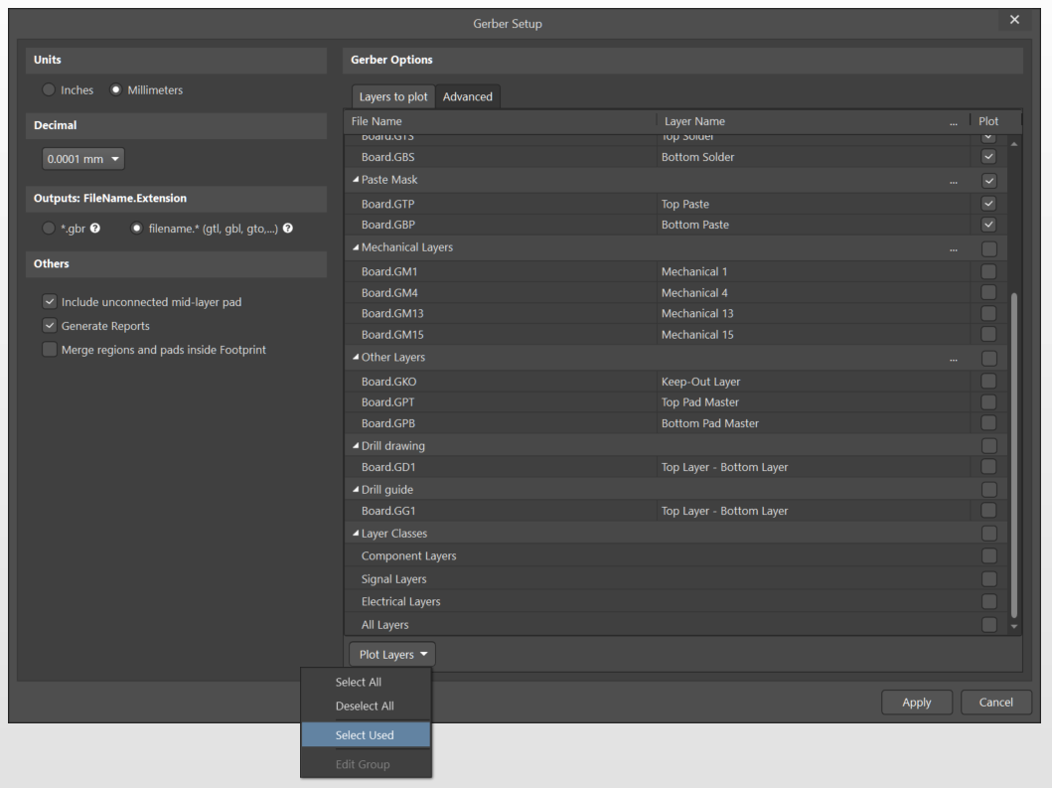

Slide 44
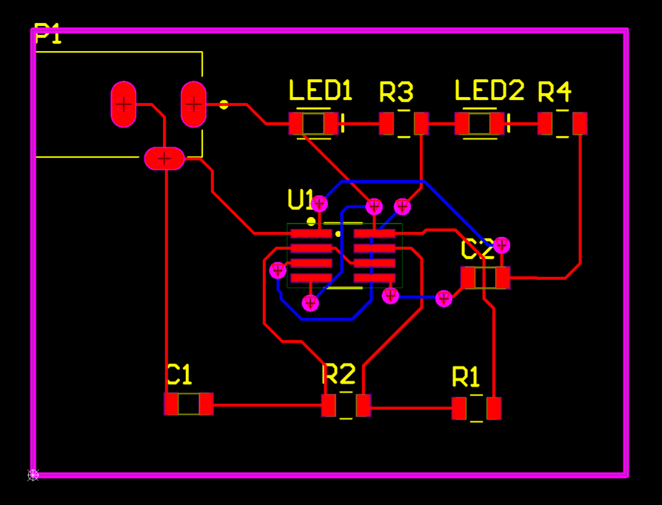
CAM job

Slide 45
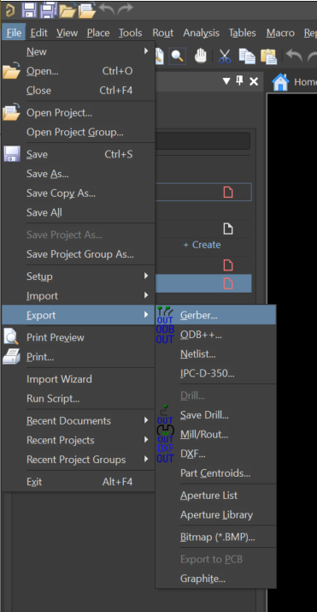
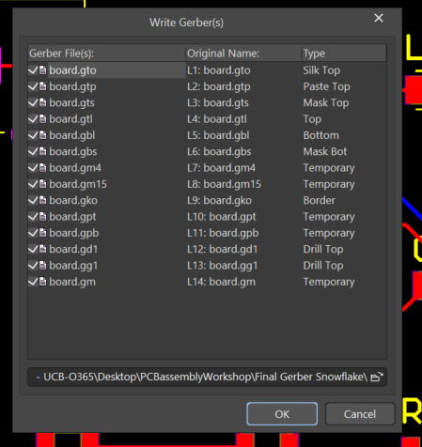
Export CAM job to Gerber

Slide 46
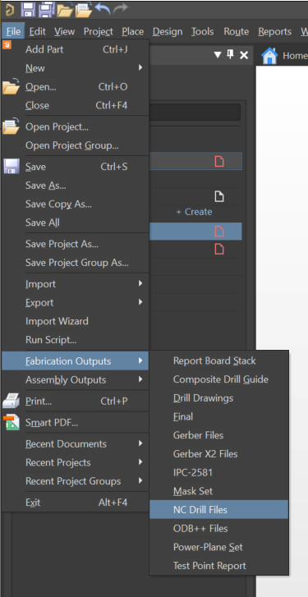
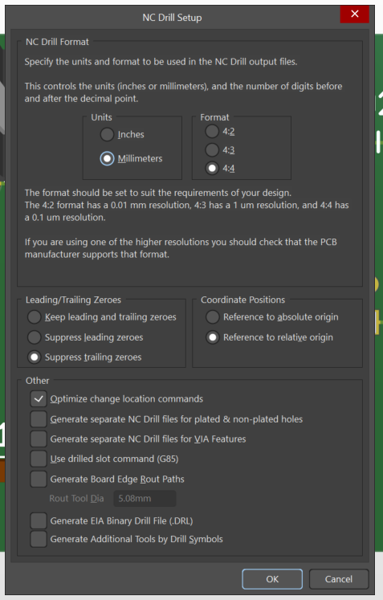
Fabricate Drill Files

Slide 47
Fabricate Drill Files

Slide 48
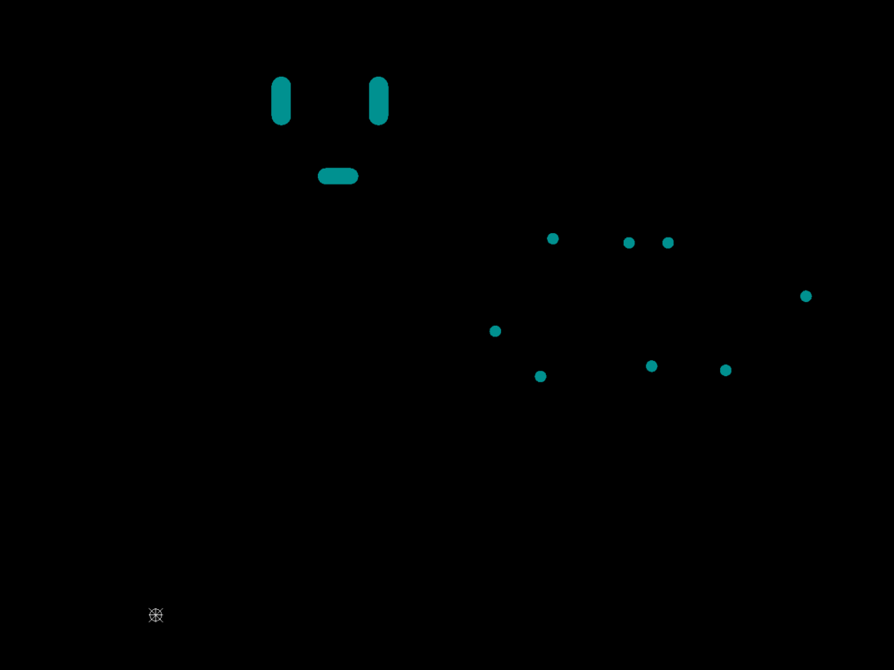
Cam Job

Slide 49
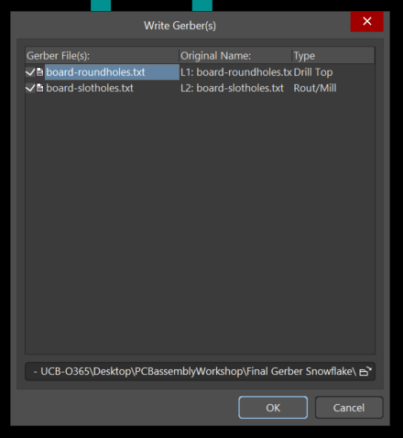
Export CAM job to Gerber

Slide 50
The end.
See your workshop instructor to receive credit.
Fall 2023

